Slide 1
Passerelles numériques
Chapter1.1: PHP OOP
A Gateway for Life
Lesson 02: Modifier

Slide 2
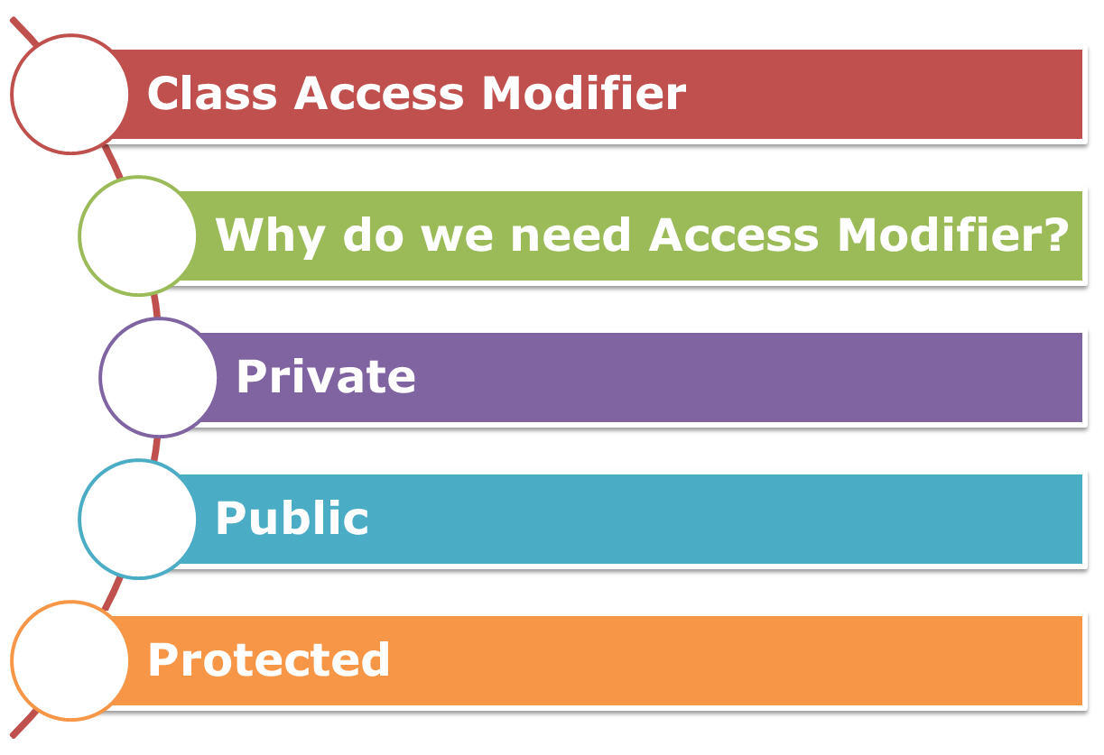
CONTENTS

Slide 3
Class Access Modifier
Access specifier specify the level of access that the outside world (Other class objects, external functions and global level code) have on the class methods and class data members. Access specifier can either be public, private, or protected.

Slide 4
Why do we need Access specifiers?
Access specifiers are used as a key component of Encapsulation and Data Hiding. By using either of the access specifiers mentioned above i.e. public, private or protected you can hide or show the internals of your class to the outside world.

Slide 5
Private
A private access specifier is used to hide the data member or member function to the outside world. This means that only the class that defines such data member and member function have access them.

Slide 6
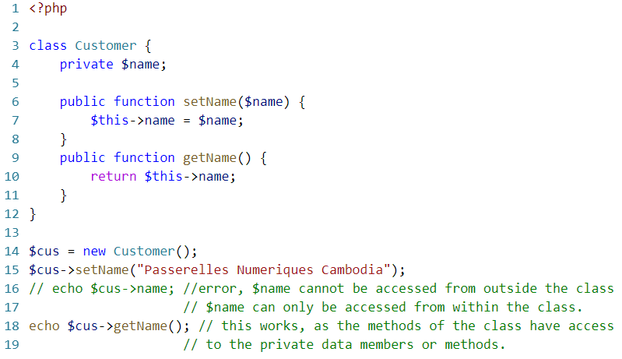

Slide 7
Public
A public access specifier provides the least protection to the internal data members and member functions.
A public access specifier allows the outside world to access/modify the data members directly unlike the private access specifier.

Slide 8
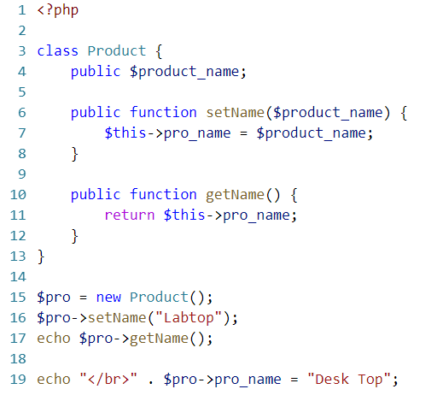

Slide 9
Protected
A protected access specifier is mainly used with inheritance. A data member or member function declared as protected will be accessed by its class and its base class but not from the outside world (rest of the script). We can also say that a protected data member is public for the class that declares it and it’s child class; but is private for the rest of the program (outside world).

Slide 10
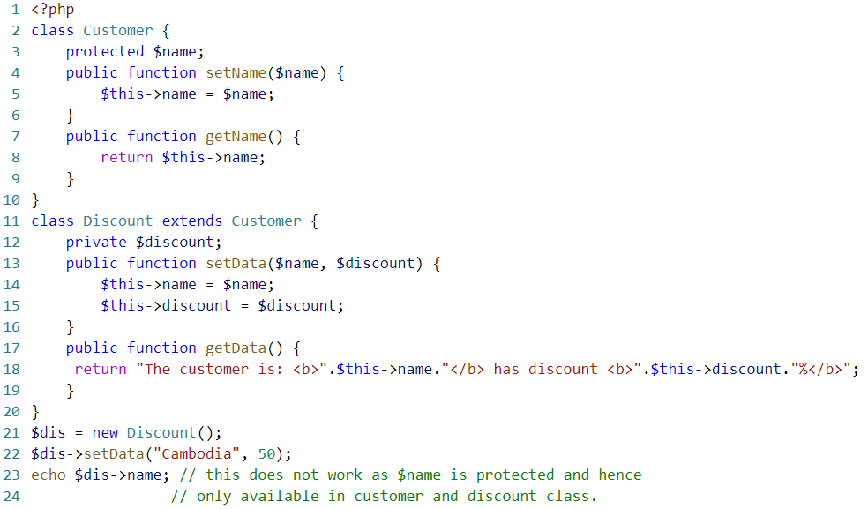

Slide 11
Important Note of Access Specifier in PHP7
In PHP7, access specifiers are public by default.
This means that if you don’t specify an access specifier for a data member or method then the default ‘public’ is applicable.

Slide 12
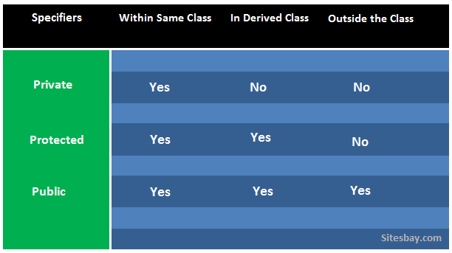
Access Specifiers in PHP

Slide 13
Homework
Write program to exchange riel to dollar using Public.
Exchange Rate for Jan-03-2019
1$ = 4000R.
Your Money exchange is 12,000,000R and exchange to dollar is 3000$
Write a program to calculate interest of banking. Mr. Vivord Rith borrowed capital from banking 10000$ with interest 10% per year and have duration 365 days. Using protected modifier. All data must prompt from method in super class.
Mr. Vivord Rith must pay interest 1000$ for duration 365 days with capital 10000$.

Slide 14


Slide 15
What have you learned?
Notes:
Ask student to give quick summary what they have learned

Slide 16
SUMMARY
Class Access Modifier
Why do we need Access Modifier?
Private
Public
Protected

